Slide 1
Testing and Debugging Tools
By:
Souvik Mandal ( 160002056 )
Biplab Kumar Sahoo ( 160001015 )
Tatavarthy Venkat Nikhil ( 160001058 )

Slide 2
Testing

Slide 3
Introduction
It is the process used to identify the correctness, completeness and quality of developed computer software.
Example: C++ testing tools(Google Test, Boost Test), Java (selenium), Python(Pytest)

Slide 4
Objective
Uncover as many as errors (or bugs) as possible in a given product.
Demonstrate a given software product matching its requirement specifications.
Validate the quality of a software testing using the minimum cost and efforts.
Generate high quality test cases, perform effective tests, and issue correct and helpful problem reports.

Slide 5
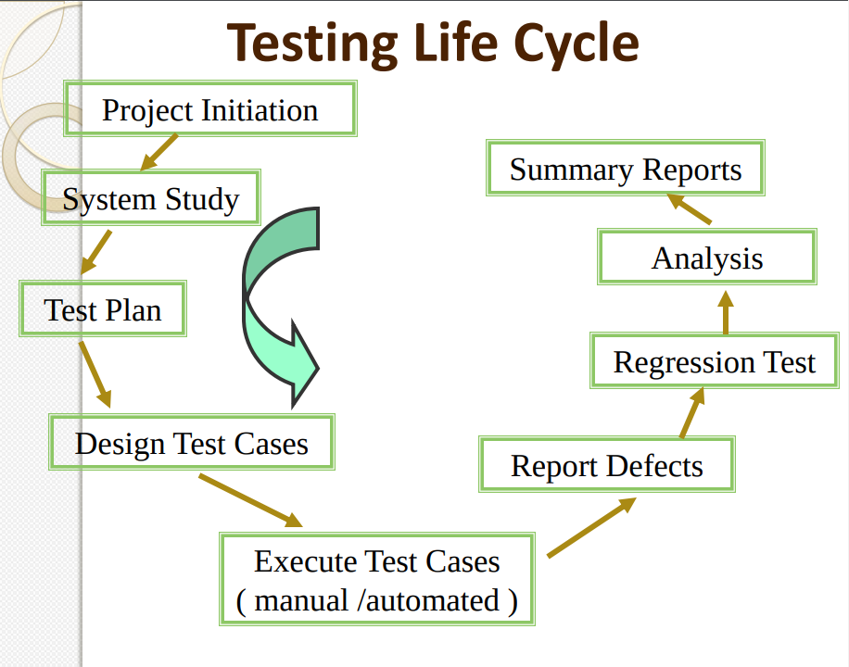
Image owner website: link

Slide 6
Testing Methodologies
Black Box Testing:
No Knowledge of program design or code
Test are based on requirements and functionality
White Box Testing:
Knowledge of internal program design and code
Test are based on paths, conditions

Slide 7
Testing Levels
Unit Testing:
Test each module individually
Done by developers
Tool Example : Boost Test, Google test
Integration Testing:
Tested after integration of unit modules
Tool Example : Selenium
System Testing:
System as a whole is tested
Requirements error
Tool Example : Selenium

Slide 8
Google Test
A library for writing c++ tests
An XUnit test framework
Open-source with new BSD license

Slide 9
Why Use Google Test
Independent and repeatable,
Tests should be well organized and reflect the structure of the tested code
Tests should be portable and reusable.
When tests fail, they should provide as much information about the problem as possible.
Tests should be fast.
Large community of supporters

Slide 10
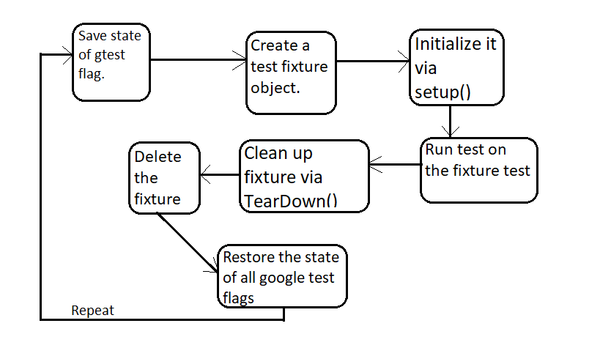
Architecture

Slide 11
Assertions
Basic Assertions: ASSERT_TRUE(cond), EXPECT_TRUE(cond),ASSERT_FALSE(cond)
Binary Comparison: ASSERT_EQ(val1,val2), ASSERT_NE(val1,val2),ASSERT_LT(val1,val2),
ASSERT_LE(val1,val2)
String Comparison: ASSERT_STREQ(str1,str2), ASSERT_NE(str1,str2), ASSERT_STRCASEEQ(str1,str2) , ASSERT_STRCASENE(str1,str2),
Death and Exception Test: Expect_DEATH(val,regx), ASSERT_THROW(statement, exception_type), ASSERT_ANY_THROW(statement).

Slide 12
Death Tests
In many applications, there are assertions that can cause application failure if a condition is not met.
If a piece of code throws an exception, we don't consider it "death" for the purpose of death tests,
Assertions:
EXPECT_DEATH(val, regx)
ASSERT_DEATH_IF_SUPPORTED(statement, regex);
ASSERT_EXIT(statement, predicate, regex);

Slide 13
Exception Test
These are for verifying that a piece of code throws (or does not throw) an exception of the given type.
ASSERTIONS:
ASSERT_THROW(statement, exception_type);
ASSERT_ANY_THROW(statement);
ASSERT_NO_THROW(statement);

Slide 14
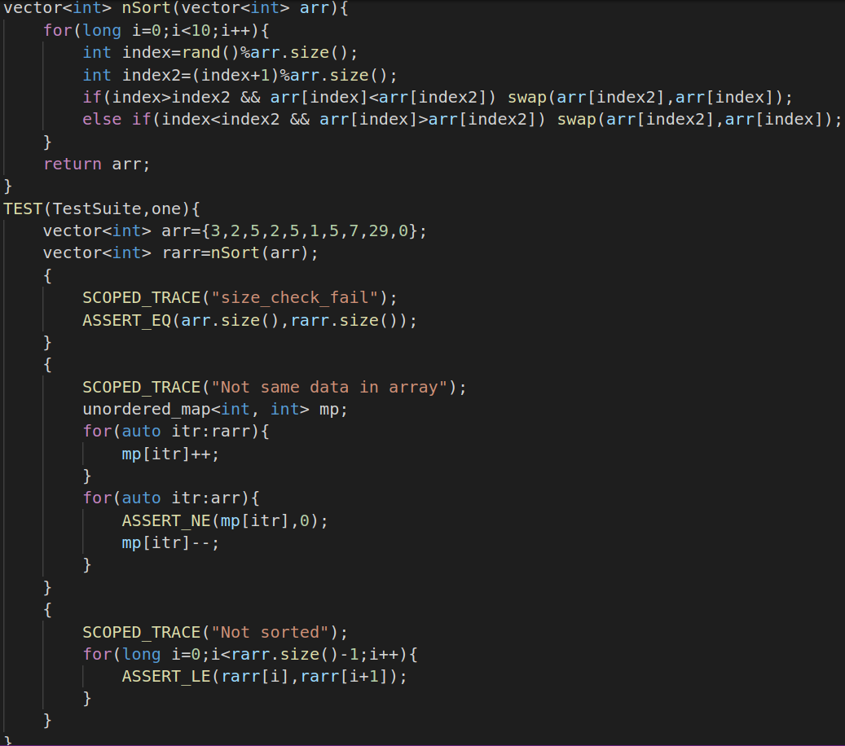
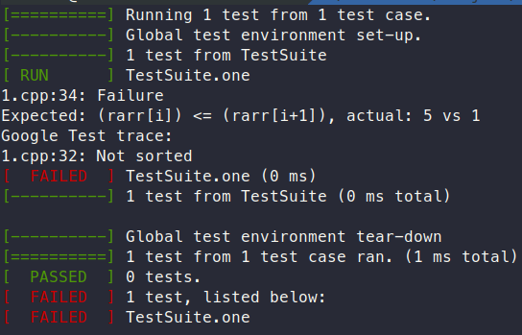
Test Example 1
Add for loop example

Slide 15
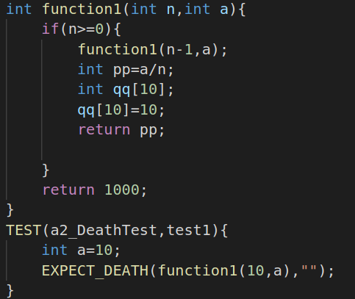
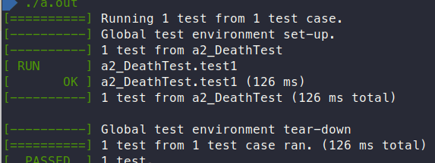
Test example 2
Any other exxample

Slide 16
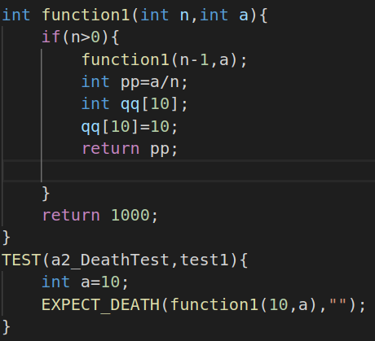
Test example 3
Any other exxample

Slide 17
Project Example
The Chromium projects (behind the Chrome browser and Chrome OS).
The LLVM compiler.
Protocol Buffers, Google's data interchange format.
The OpenCV computer vision library.
tiny-dnn: header only, dependency-free deep learning framework in C++11.

Slide 18
Limitations
Google Test is designed to be thread-safe. The implementation is thread-safe on systems where the pthreads library is available. It is currently unsafe to use Google Test assertions from two threads concurrently on other systems (e.g. Windows). In most tests this is not an issue as usually the assertions are done in the main thread.

Slide 19
Boost Test
A library for writing c++ tests
An XUnit test framework
Boost Software License

Slide 20
Why Use Boost Test
The framework provides a uniform (and well-supported) testing and reporting environment.
Using the framework simplifies the process of creating and maintaining unit tests:
extensible logging, XML and JUNIT outputs for third-party tools (eg. cont. integration)
provide assertion context for advanced diagnostic on failure
powerful and extensible dataset tests

Slide 21
Boost.test vs GTest
Boost.Test | Google Test
Does not support mock object. | Support mock object.
Extended feature with event mechanism not supported. | Extended feature with event mechanism supported.
Does not support distributed machine architecture. | Support distributed machine architecture
Does not provide thread safety while running. | Provide thread safety.

Slide 22
Assertions
BOOST_TEST(predicate)
BOOST_CHECK(predicate)
BOOST_WARN(predicate)
BOOST_REQUIRE(predicate)
BOOST_CHECK_EQUAL(val1,val2)
BOOST_WARN_EQUAL(val1,val2)
BOOST_REQUIRE_EQUAL(val1,val2)

Slide 23
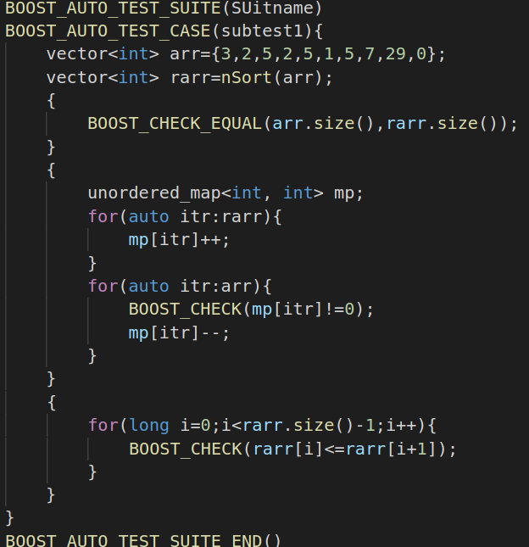
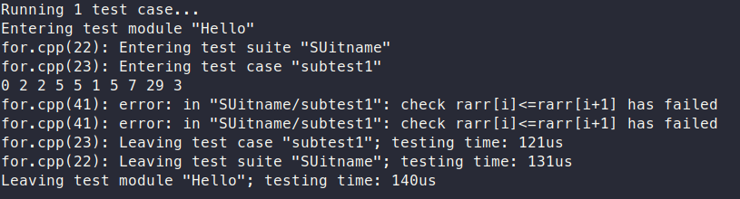
Test Example 1
Add for loop example

Slide 24
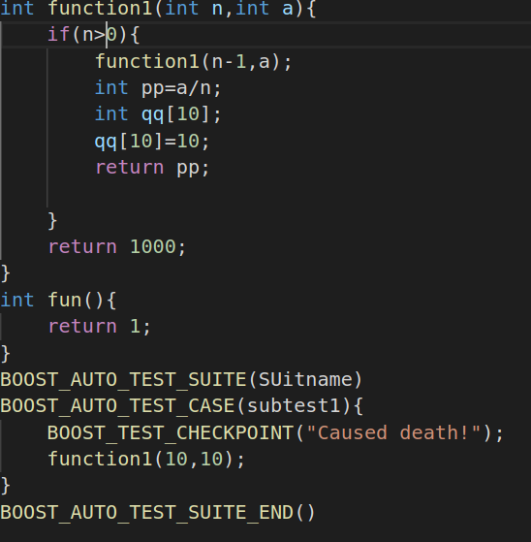
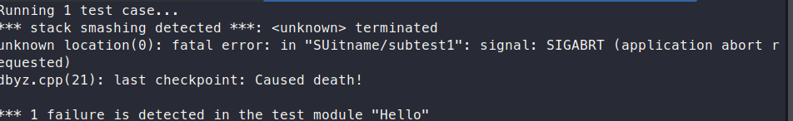
Test example 2
Any other exxample

Slide 25
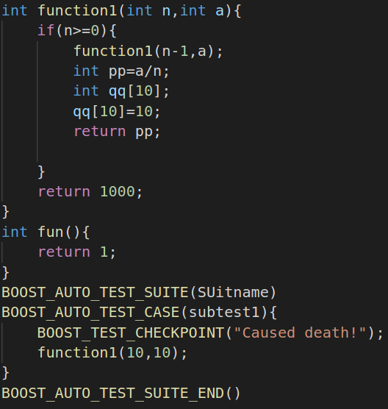
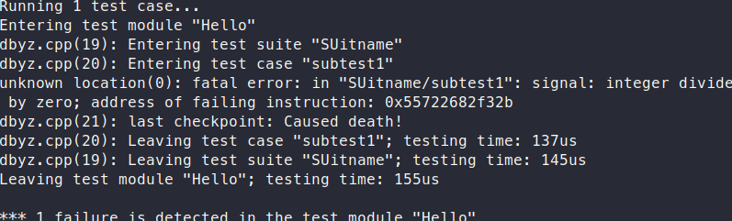
Test example 3
Any other exxample

Slide 26
Limitation
It is not suitable for most multi-threaded tests.
It is not suitable for “one-piece” applications (such as server or CGI). Such applications should be tested via their clients (which would preferably be unit test based).

Slide 27
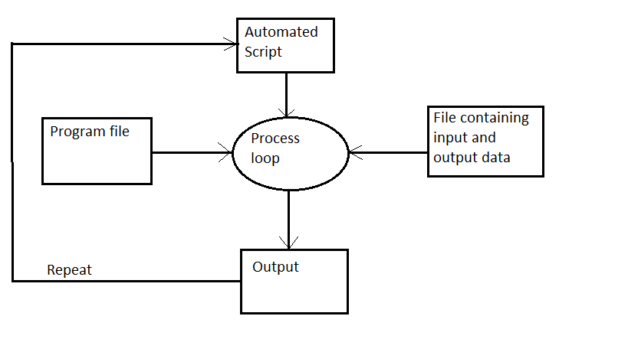
Manual Testing

Slide 28
Manual Test vs Test Library
Manual Test | Test Library
Not Portable, depends on RTTI, compilers | Portable, does not depends on RTTI, Compilers
Manual start of test units | Automatically detects test units
Does not share resource across tests. | Share resource across tests.
Mock object, Distributed machine not supported | Mock object, distributed machine supported

Slide 29
Test Automation Using Selenium

Slide 30
Selenium
Selenium is a robust set of tools that supports rapid development of test automation for web-based applications.
Selenium provides a rich set of testing functions specifically geared to the needs of testing of a web application.
Selenium operations are highly flexible, allowing many options for locating UI elements and comparing expected test results against actual application behavior.

Slide 31
Selenium Features
Supports Cross Browser Testing. The Selenium tests can be run on multiple browsers.
Allows scripting in several languages like Java, C#, PHP and Python.
Assertion statements provide an efficient way of comparing expected and actual results.
Inbuilt reporting mechanism.

Slide 32
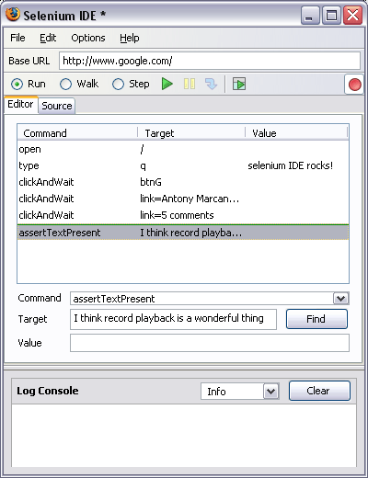
Selenium IDE - UI
Start and Stop
Recording
Replay
Toolbar
Selenium
Script
Editor
Accessor
Area
Selenium Log

Slide 33
Recoding a Selenium Test Case
Open Firefox that has the IDE installed
Open the base URL of the application to record.
Keep the application in a common base state.
Go To Tools 🡪 Selenium IDE and the IDE will be opened
Now perform the operations on the application as you are testing the application.
Once you are done with the recording click on the stop recording button and save the test case through the file menu. By default it will be saved as a selenium script (HTML format)

Slide 34
Running Selenium Script
Make sure the application is in the common base state.
Click on the run button. Here you can also control the speed of the execution using the toolbar
Once the test is run you can view the test log in the bottom of the IDE window

Slide 35
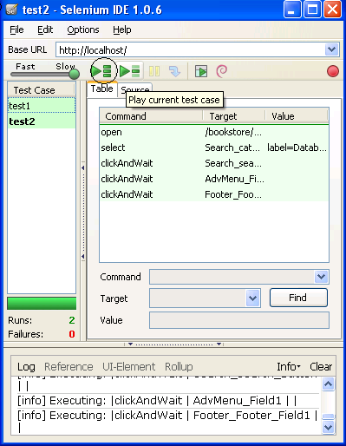
Creating a Test Suite
In the Selenium IDE you can create any number of test cases and save them as test suite.
To Run the test Suite click on the “Play entire test suite” button as shown below.
Test Suite with
Test1 & test2

Slide 36
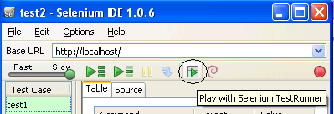
Playing The test Suite with Test Runner
Test Runner allows you to run the test case in a browser loaded with the Selenium-Core TestRunner.
Test runner is invoked by clicking the below Shown button in the IDE
On Clicking the Test Runner Button you will the window as seen in the next slide

Slide 37
Assertion Statements
assertTextPresent
This will assert if the text is present in the page.
assertText
This will assert if a particular element is having the particular text.
assertTitle
This will assert if the page is having a proper title.
assertValue
This will assert if a Text box or check box has a particular value
assertElementPresent
This will assert if a particular UI Element is present in the page.

Slide 38
Limitations of Selenium IDE
Can run the test only on Firefox
No Programming login (like loops, conditional statements) can be applied
Selenium IDE can execute scripts created in Selenese only.
It is difficult to use Selenium IDE for checking complex test cases involving dynamic contents

Slide 39
Selenium RC
A solution to cross browser testing.
A server, written in Java and so available on all the platforms.
Acts as a proxy for web requests from them.
Client libraries for many popular languages.
Bundles Selenium Core and automatically loads into the browser

Slide 40
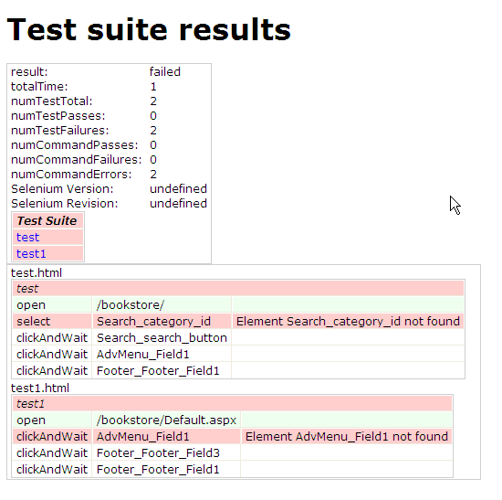
Selenium Suite
Command :
java -jar selenium-server.jar -multiwindow -htmlSuite "*iexplore" "https://localhost/bookstore/" "D:\testa.html" "C:\results.html“
Once the command is run the results will be stored in the results.html file as shown below.

Slide 41
Process of Developing Selenium Java Scripts.
Following are the steps for generating the
test scripts in java
Record the Script in Selenium IDE and format them into Java
Create a Selenium Java project in Eclipse and load all the necessary jar files
Copy the formatted Java code into the Eclipse and run the test.

Slide 42
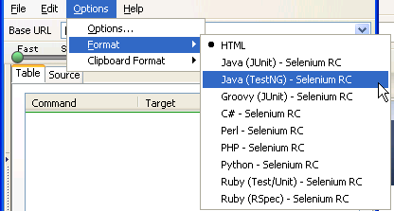
Formatting the recorded script into Java
Steps of formatting the code into java
Open the Browser and open the base URL of the application.
Open the Selenium IDE and start recoding the test steps.
Once the recording is done go to Menu 🡪 Options 🡪 Format 🡪 Java(TestNG) –Selenium RC
You can see the java code in the source tab of IDE. Save the test case with .java extension.

Slide 43
Setting Up an Eclipse Project for Selenium Automation
Eclipse is an open source community whose projects are focused on building an extensible development platform for building Java applications and frameworks. Eclipse is one of the best Java IDE and as a matter of face Eclipse is much more than a Java IDE.
We can configure a selenium project in eclipse and even run the scripts from eclipse.
Using eclipse its easy to enhance the recorded script. We can add power to the recorded script by parameterizing the test inputs and even validate the back values.
Eclipse also allows us to write reusable code for efficient test automation.

Slide 44
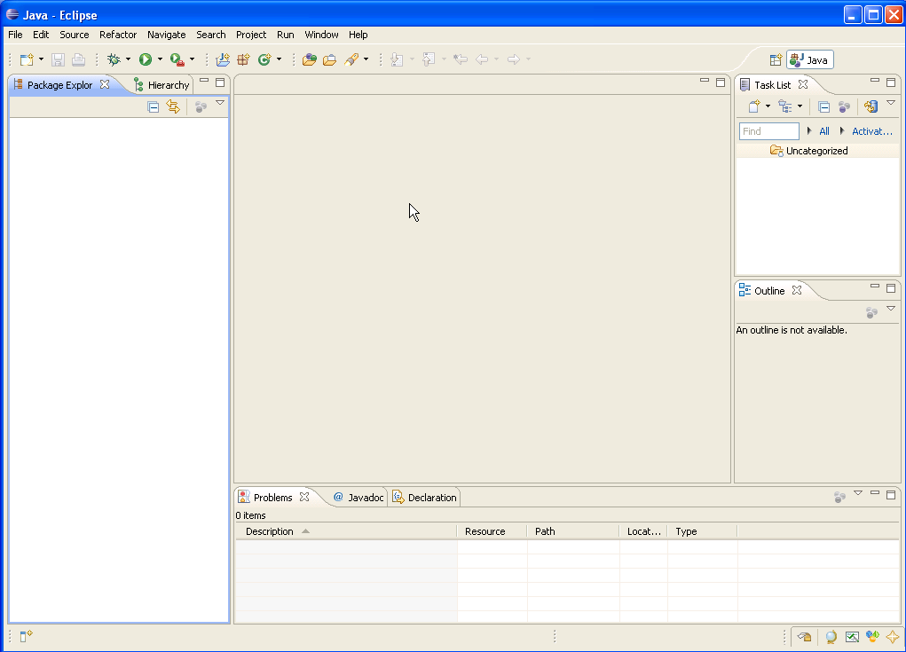
Eclipse IDE
Scrip View
Package
Explorer
console

Slide 45
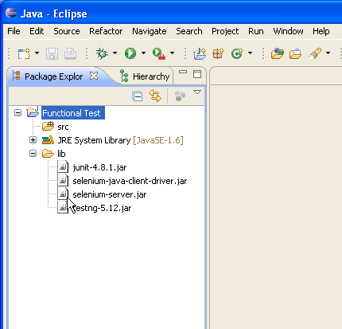
Selenium Libraries

Slide 46
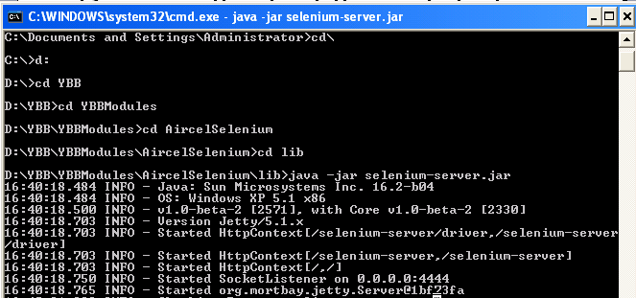
Running the test through Eclipse
Start the Selenium Server
For this open the command prompt and go to the folder where the selenium server is present.
Run the command “java -jar selenium-server.jar”
The Selenium server will start running and you can see the message in the command prompt.

Slide 47
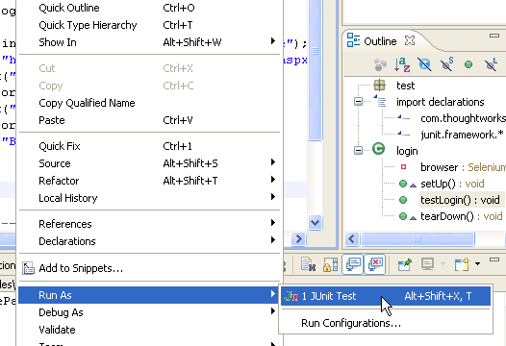
Running the test through Eclipse
Once the server is up go to the eclipse and right click on the script.
In that select Run As 🡪 JUnit Test. See the image below. After this you will get will see that the script has run successfully in the window that’s shown in the next slide.

Slide 48
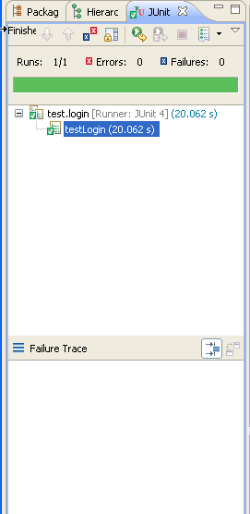
Selenium Results Strip in the Eclipse IDE
success
failure

Slide 49
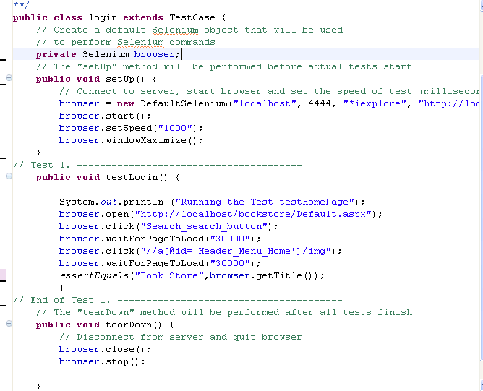
Script View

Slide 50
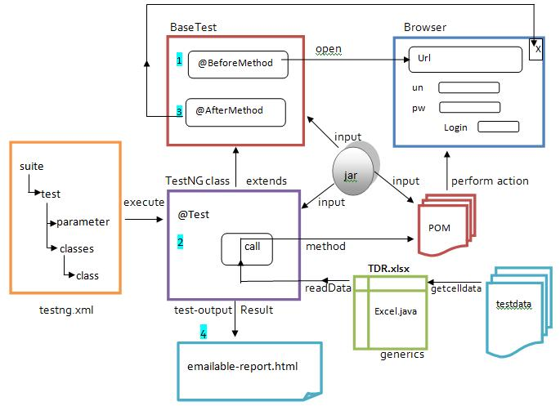
Selenium webdriver community
Selenium Webdriver Community

Slide 51
package newproject;
import org.openqa.selenium.WebDriver;
import org.openqa.selenium.firefox.FirefoxDriver;
public class PG1 {
public static void main(String[] args) { System.setProperty("webdriver.firefox.marionette","C:\\g eckodriver.exe");
WebDriver driver = new FirefoxDriver();
String baseUrl = “https://www.wikipedia.org/";
String expectedTitle = "Welcome: Mercury Tours";
String actualTitle = ""; driver.get(baseUrl); actualTitle = driver.getTitle();
if (actualTitle.contentEquals(expectedTitle)){ System.out.println("Test Passed!");}
else { System.out.println("Test Failed");}
driver.close();}
}

Slide 52
The above code is simply to test that if the page url provided is having the same title as the expected title or not.
Benefits
-open source
-supports multiple languages like java, perl, ruby, c#, python.
-can be run in windows, mac, linux or UNIX

Slide 53
Automation tools are used to execute test cases.
Faster than manual approach.
Regression, Performance, Load testing is suitable.
Automated Tests have zero risks of missing out a pre-decided test.
Not cost effective for low volume regression
Can be done on different parallel operating platforms reducing time taken.
Test Cases are manually tested by analysts.
Time consuming takes up human resource.
Exploratory, usability testing is suitable.
Manual testing may have risk of missing out a such test.
Not cost effective for high volume regression
Only time can be reduced by increasing manpower.

Slide 54
Py.test

Slide 55
Example
from unnecessary_math import multiply
def test_numbers_3_4():
assert multiply(3,4) == 12
def test_strings_a_3():
assert multiply('a',3) == 'aaa'

Slide 56
How to run cases?
python -m pytest test_um_pytest.py
py.test test_um_pytest.py

Slide 57
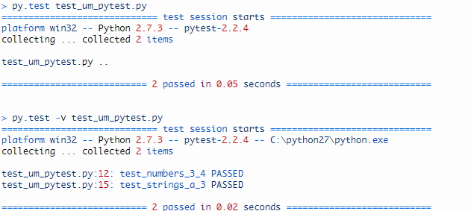
Result

Slide 58
Assertions
•assert expr
•assert a == b
•self.assertEqual(a, b)
•assert expr, “Expected message”

Slide 59
Assertion Example
#content of conftest.py
def pytest_assertrepr_compare(op,left,right):
if(isinstance(left,foo)
and isinstance(right,foo)
And op==”==”):
Return [‘comparing foo instances:’,’vals:{0.val}!={1.val}’.format(left,right)]

Slide 60
Assertion Example
def test_compare():
assert foo(1)==foo(2)
assert f1==f2
assert comparing foo instances: vals: 1!=2

Slide 61
Assertions
Py.test refined `assert` statement
Note: ‘assert expr, msg’ won’t output traceback

Slide 62
Debugging

Slide 63
Introduction:
Debugging is a process of finding and reducing the number of bugs, or defects. Debugging occurs as a consequence of successful testing.
That is, when a test case uncovers an error, debugging is the process that results in the removal of the error.

Slide 64
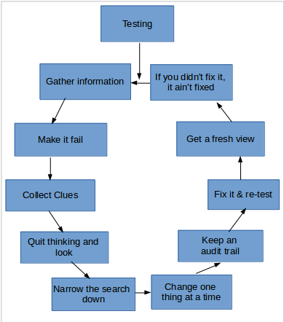
Steps of Debugging
1. Gather information 8. Fix it & re-test
2 Make it fail 9 Get a fresh view
3 Collect Clues 10 If you didn't fix it, it ain't fixed
4. Quit thinking and look
5. Narrow the search down
6. Change one thing at a time
7. Keep an audit trail

Slide 65
1.Gather Information
Know the fundamentals of the system.
Understand the frameworks involved.
Read the APIs and communication interfaces.
Understand what each module of the system does.

Slide 66
2. Make it Fail
Start at the beginning.
Automate the failure.
No detail is insignificant.
Intermittent failures?
Isolate the failure.

Slide 67
3. Collect Clues
Collect clues as to bug
Clues suggest where problem might be
ex:using type of error,etc.

Slide 68
4. Quit Thinking and Look
Gather the low level details and "see" the failure.
Understand the context of the bug.
Be methodical.
Make no assumptions.

Slide 69
5. Narrow the Search
Start at the bad end (e.g. the error log) and work your way up the chain looking at the various.
Fix the bugs you know about - fixing one could fix the other

Slide 70
6. Change one thing at a time
Compare with a good one !
Use a rifle not a shotgun.
What’s changed recently, it used to work!

Slide 71
7. Keep an Audit Trail
Keep a day book of what you did.
During debugging write down...
1.What you did… 2.In what order… 3.And what happened!
Be specific and consistent.

Slide 72
8.Fix it & Re-test
Attempt to replicate again
• No temporary workarounds!
• May introduce other issues.
• Never get replaced with true solutions.

Slide 73
9. Get a Fresh View
Get another viewpoint on the solution.
Talk to somebody about the problem.
Ask an expert:
● Email the author
● Check the forums
● Subscribe to the mailing list

Slide 74
10. If you didn’t Fix it, it ain’t fixed
The most important lesson by far...
●Fix the root cause
●Make sure it can’t possibly happen again
●Fix the process at fault

Slide 75
Common types of debugging:
Brute force
Print/Trace Debugging
Backtracking Method
Divide & Conquer

Slide 76
Brute Force
Most common and least efficient for isolating the cause of a software error.
• a printout of all registers and relevant memory locations is obtained and studied. All dumps should be well documented and retained for possible use on subsequent.

Slide 77
2. Print/Trace Debugging
Watching the flow of execution after adding print statements to the original code.
Post Mortem Debugging - analysis of a memory dump from a program that has crashed.

Slide 78
3. Backtracking method
• The process starts from the site where a particular symptom gets detected, from there on backward tracing is done across the entire source code till we are able to lay our hands on the site being the cause.
• Unfortunately, as the number of source lines increases, the number of potential backward paths may become unmanageably large.

Slide 79
4. Divide & Conquer
Identify different code sections Set breakpoints at the boundaries Isolate issue to one particular area.
Focus efforts on that area introduces the concept of binary partitioning.

Slide 80
4. Divide & Conquer
Identify different code sections Set breakpoints at the boundaries Isolate issue to one particular area.
Focus efforts on that area introduces the concept of binary partitioning.

Slide 81
Debugging Tools

Slide 82
Advantages of using Debugging Tools
As debugging is the hardest and most time consuming part of programming, any improvement in that process can make as big difference as between minutes and weeks.
Possible to interactively debug executing program (or its trace) - to setup a breakpoint and preview current value of variables, etc.

Slide 83
GDB

Slide 84
Introduction
GDB may not be intuitive but it is very powerful
Easy to use, just not so easy to learn (TUI: Text User Interface)
As useful as it is poorly named!

Slide 85
Features
GDB offers extensive facilities for tracing and altering the execution of computer programs.
The user can monitor and modify the values of programs' internal variables, and even call functions independently of the program's normal behavior.

Slide 86
Execution Instructions:
g++ -g program.cpp (for c : gcc -g program.c)
gdb ./a.out

Slide 87
Commands
r-run c-continue
f - Runs until the current function is finished
s - Runs the next line of the program
s N - Runs the next N lines of the program
n - Like s, but it does not step into functions
u N - Runs until you get N lines in front of the current line

Slide 88
Commands Cont.
p var - Prints the current value of the variable "var"
bt - Prints a stack trace
u - Goes up a level in the stack
d - Goes down a level in the stack
q - Quits gdb
*(Other commands in research files)

Slide 89
Types of errors
seg fault - detected divide by 0 - detected
memory leak - undetected access unallocated memory - detected
access unallocated memory (static) - detected
access uninitialized memory - undetected
overflow - undetected

Slide 90
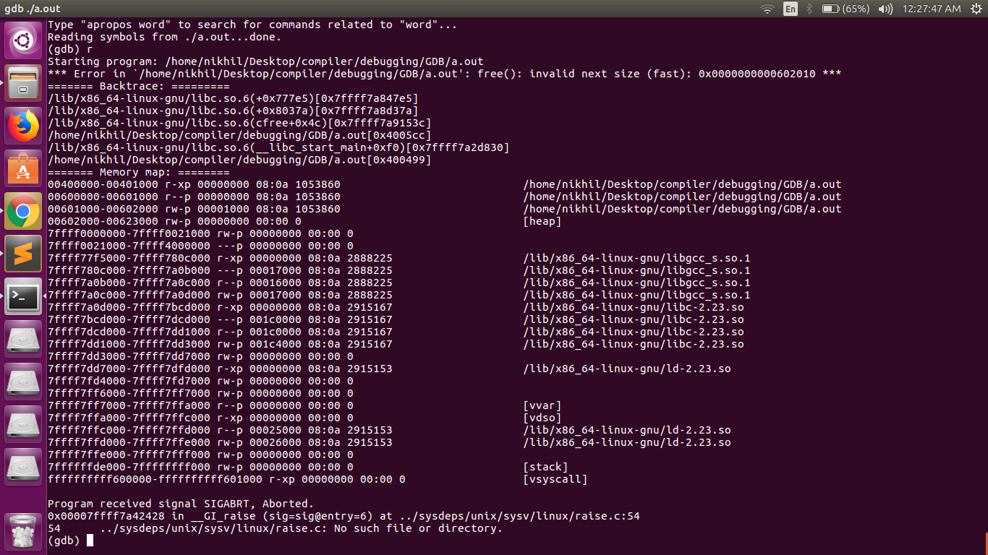
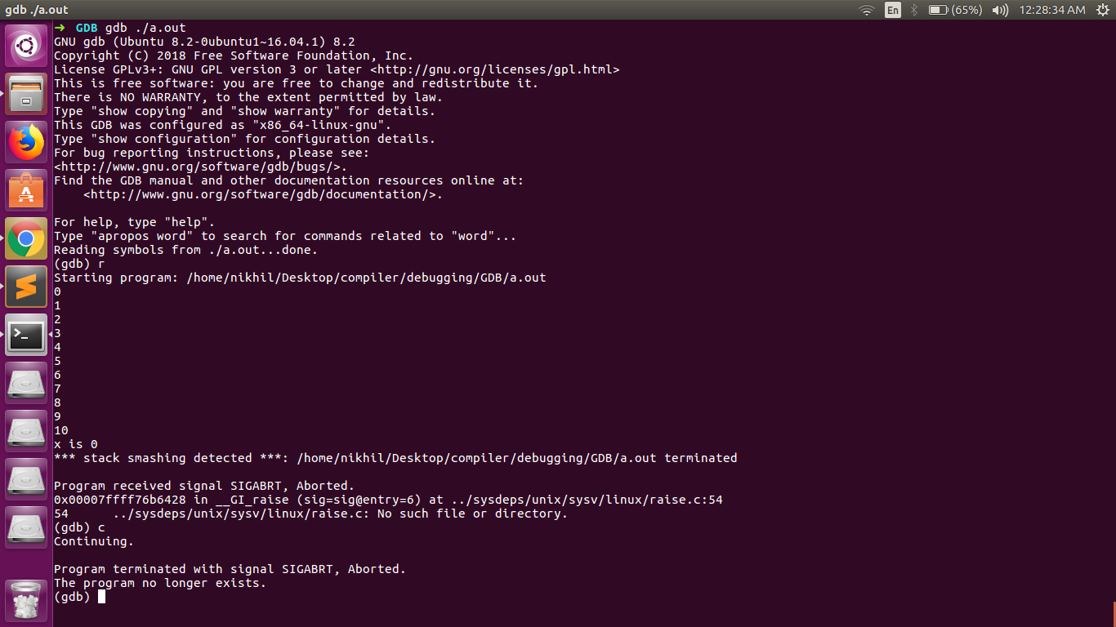
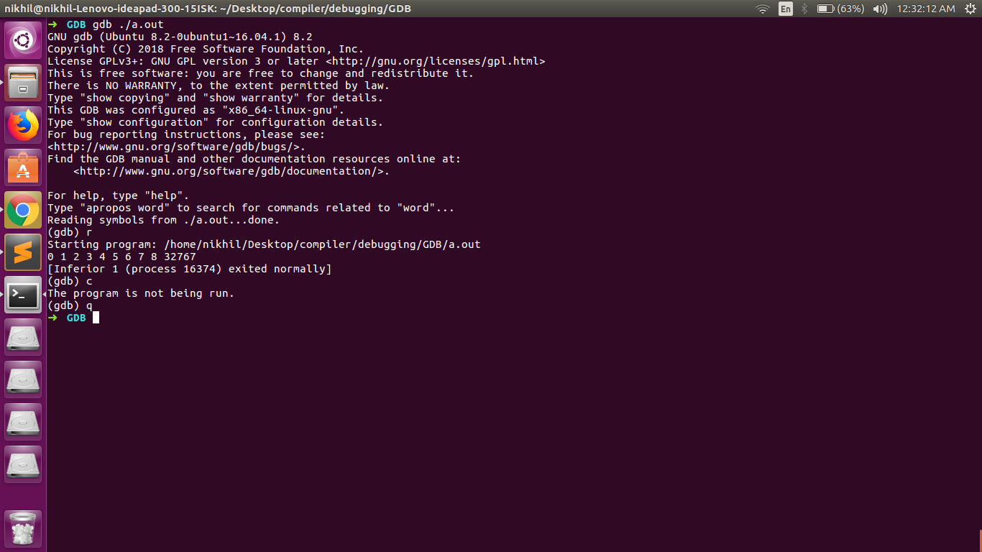
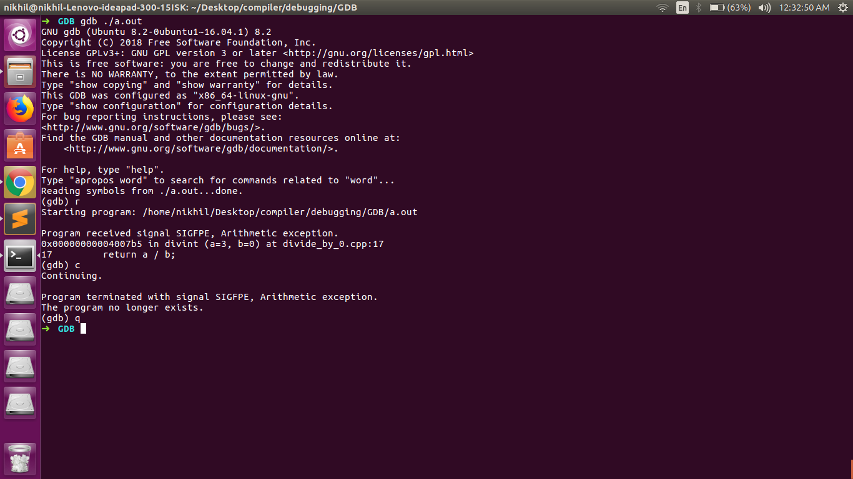
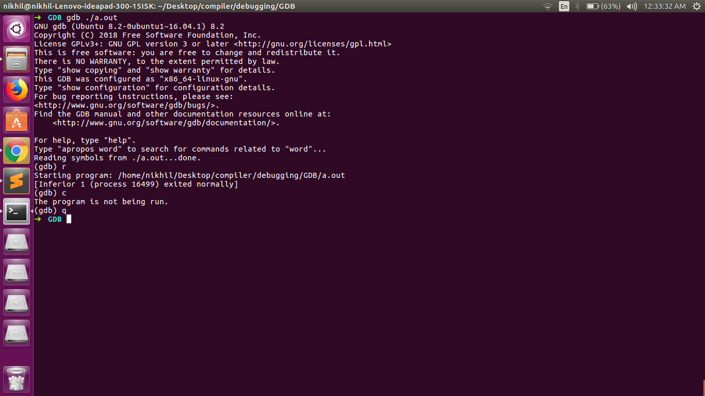
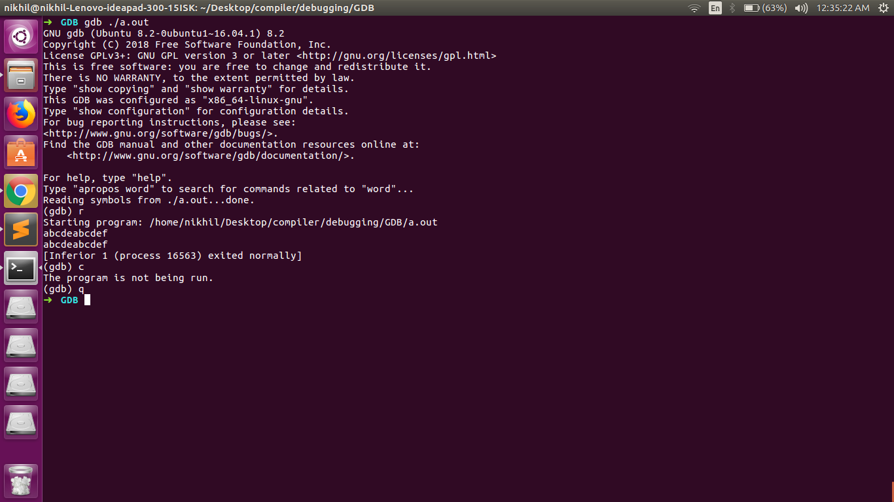
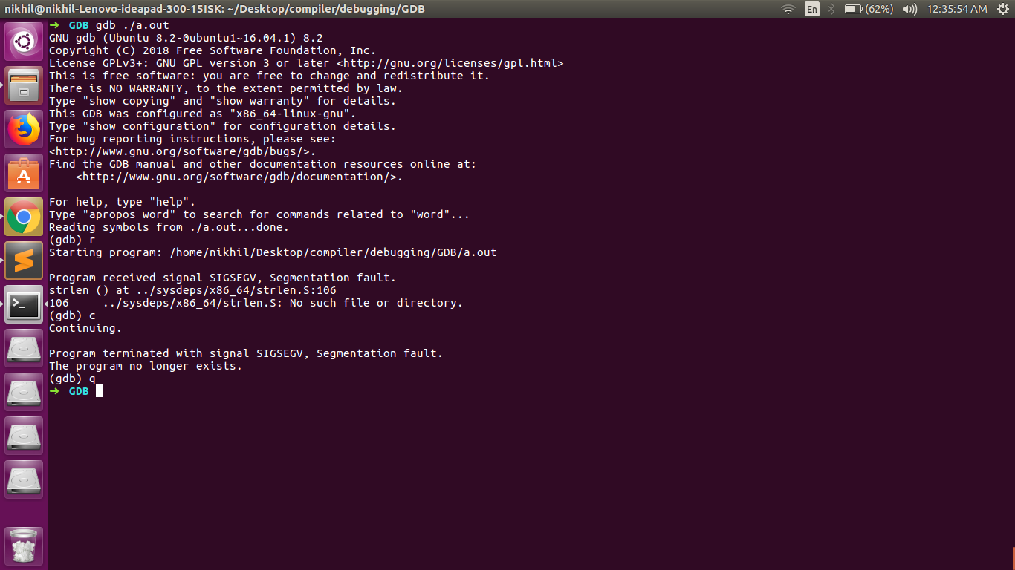
*(code and output screenshots are given in research folder)

Slide 91
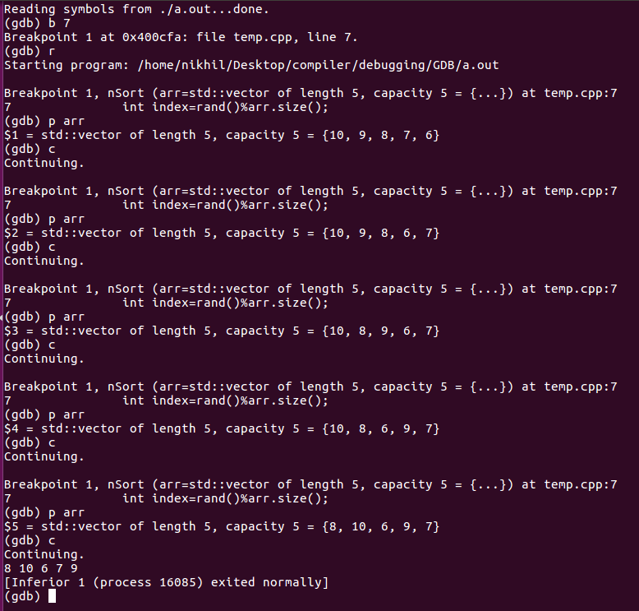
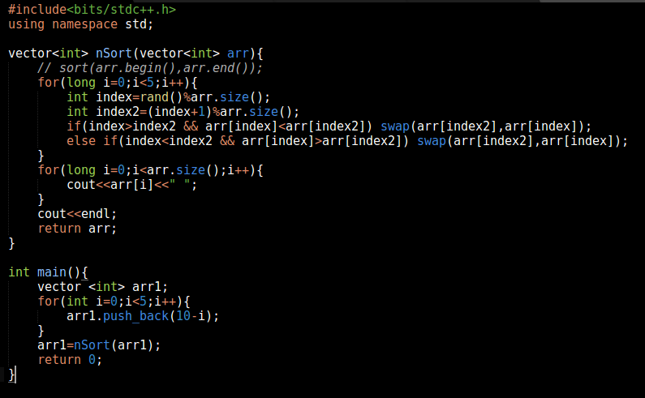
Example 1(Sorting)

Slide 92
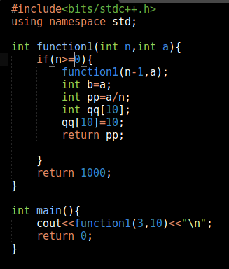
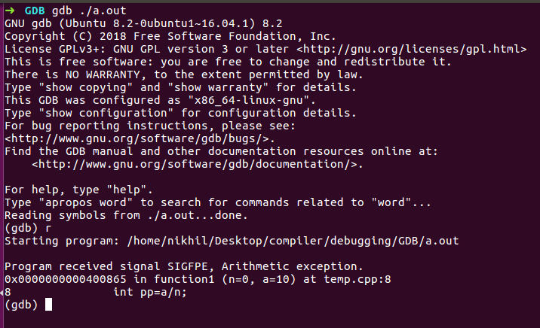
Example 2(Masking)

Slide 93
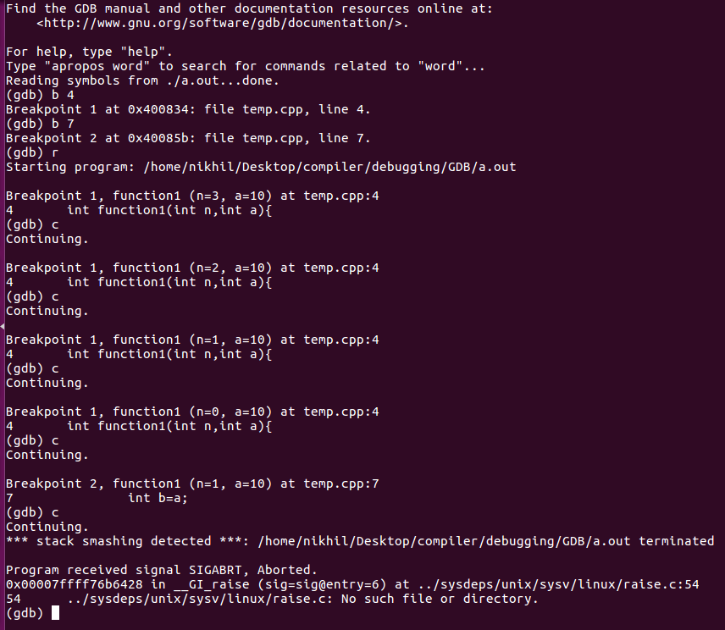
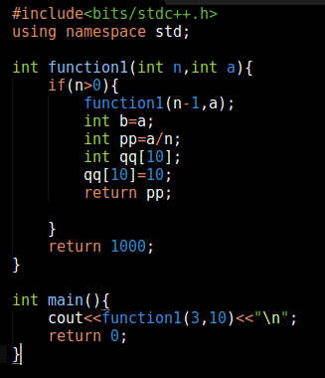
Example 2(Masking) Cont.

Slide 94
Valgrind

Slide 95
Introduction
Valgrind is a memory mismanagement detector. It shows you memory leaks, de-allocation errors, etc. Actually, Valgrind is a wrapper around a collection of tools that do many other things (e.g., cache profiling).

Slide 96
Features
Memcheck - memory leak detection
Cachegrind - collecting data about cache hits/mises
Callgrind - analysing function calls,
Massif - analyse memory comsuption
Helgrind - analyze synchronization errors

Slide 97
Execution Instructions
g++ -Wall -pedantic -g program.cpp
(for c : gcc -Wall -pedantic -g program.c)
valgrind ./a.out

Slide 98
Types of errors
seg fault - detected divide by 0 - detected
memory leak - detected access unallocated memory - detected
access unallocated memory (static) - detected
access uninitialized memory - detected
overflow - detected

Slide 99
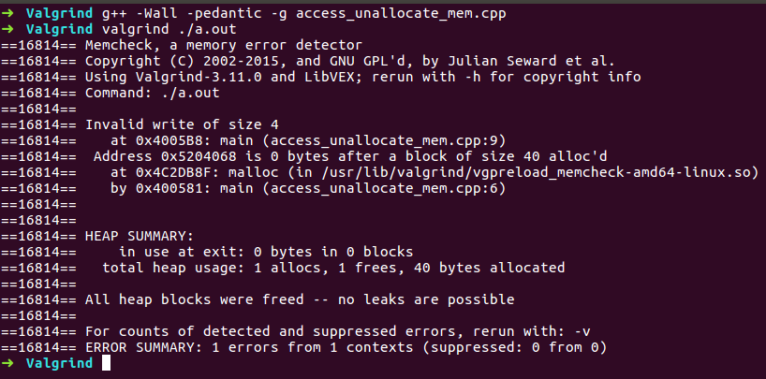
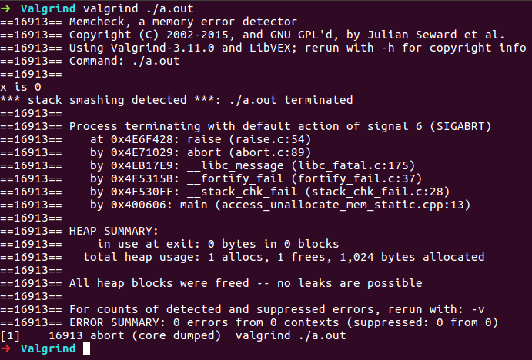
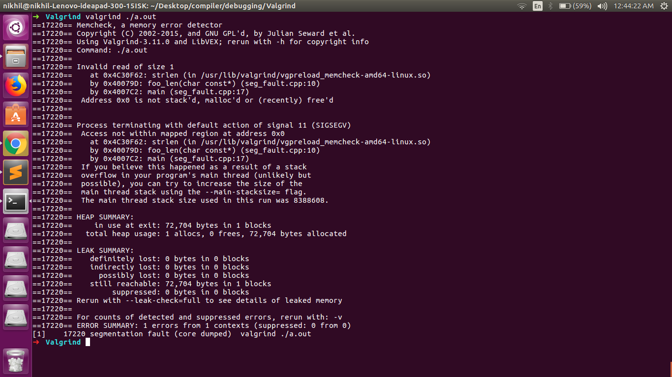
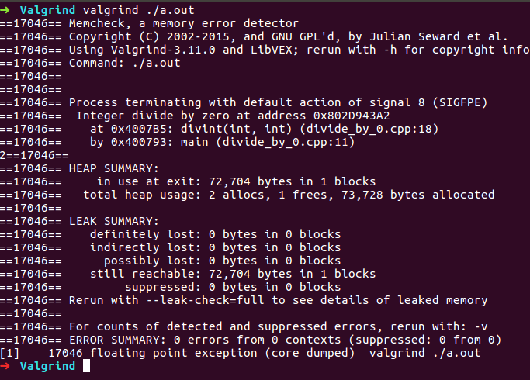
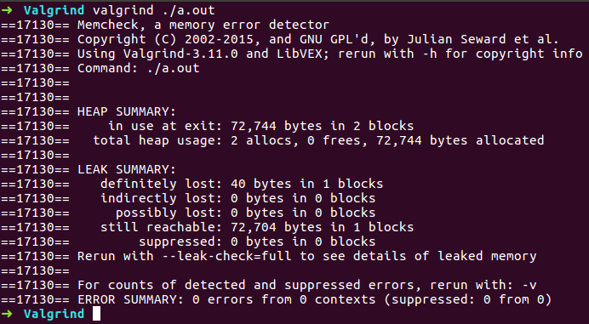
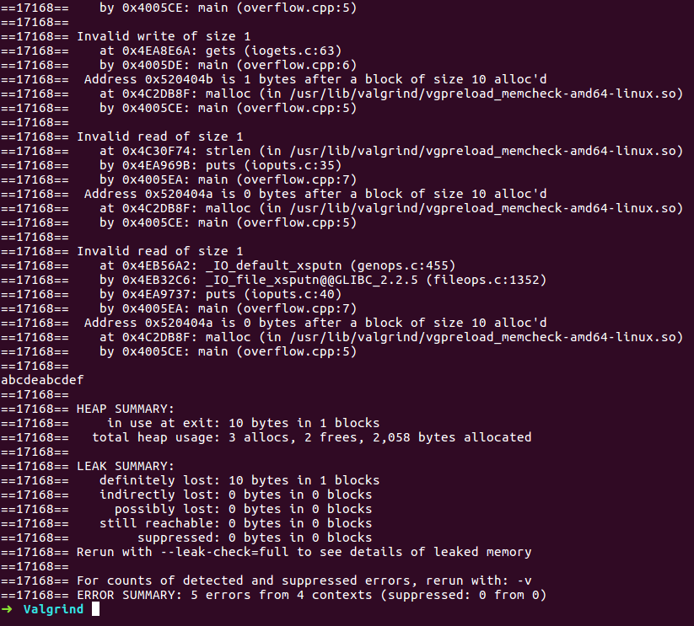
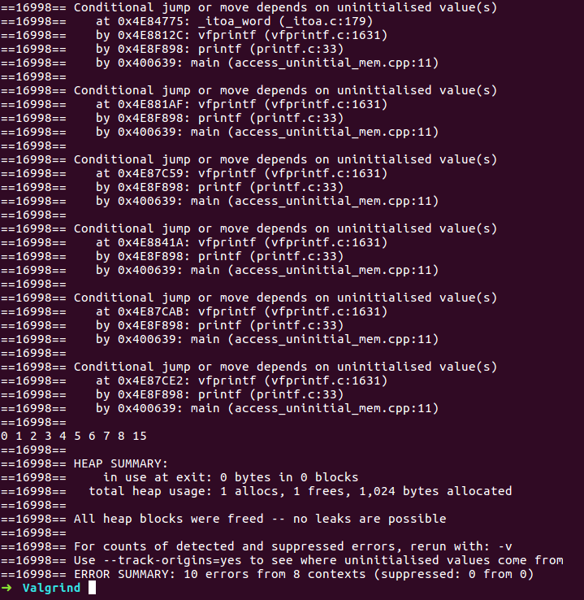
*(code and output screenshots are given in research folder)

Slide 100
Kdevelop

Slide 101
Introduction
KDevelop is a modern integrated development environment (IDE) for C++ (and other languages) that is one of many KDE applications.
It is a GUI

Slide 102
Features
Low Resource Cost.
Full Language Support
Context-Based Completion
GUI-Integrated VCS
Pop-Up Navigation
Easy Adaptation

Slide 103
Execution Instructions
Open Kdevelop application
Attach the code
Use debug option
Possible to insert breakpoints, etc. using the interface(gdb commands)

Slide 104
Types of errors
seg fault - detected divide by 0 - detected
memory leak - undetected access unallocated memory - detected
access unallocated memory (static) - detected
access uninitialized memory - undetected
overflow - undetected

Slide 105
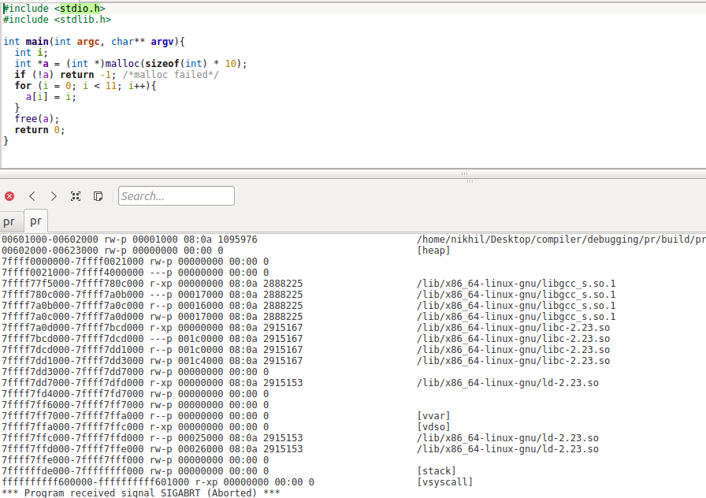
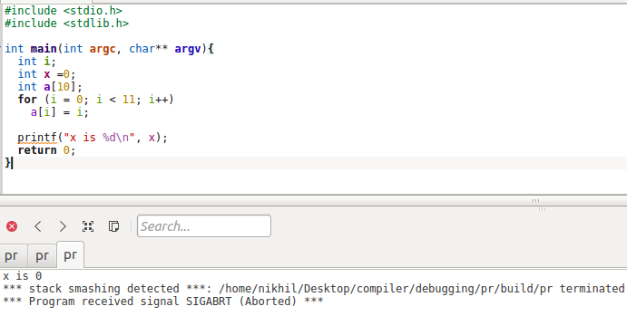





*(code and output screenshots are given in research folder)

Slide 106
Nemiver

Slide 107
Introduction
Nemiver is a project to write a standalone graphical debugger that integrates well in the GNOME desktop environment.
It currently features a backend which uses the well known GNU Debugger gdb

Slide 108
Features
In addition to the toolbar buttons, you can toggle breakpoints simply by clicking in the margin on the line you want to break on.
-Attaching to a running process is as simple as typing "nemiver --attach <the-name-of-your-program>". You are not obliged to know the PID of the process beforehand.

Slide 109
Execution Instructions
g++ -g program.cpp (for c : gcc -g program.c)
nemiver ./a.out

Slide 110
Types of errors
seg fault - detected divide by 0 - detected
memory leak - undetected access unallocated memory - detected
access unallocated memory (static) - detected
access uninitialized memory - undetected
overflow - undetected

Slide 111







*(code and output screenshots are given in research folder)

Slide 112
Tips on Debugging
1. Computers aren’t random, and neither are bugs.
2. Persistence will always pay off.
3. Don’t be afraid to dive deep.
4. Don’t make assumptions or take things for granted.

Slide 113
Long-Term results
• Gain experience
• Learn how the system works
• Develop a “sixth sense”

Slide 114
Quotations
“The bug is not moving around in your code, trying to trick or evade you.
It is just sitting in one place, doing the wrong thing in the same way every time.”
“ If debugging is the process of removing software bugs, then programming must be the process of putting them in. ”
“First, solve the problem. Then, write the code.”
“Error messages are your best friend. : You will grow to love them for the useful information they give you.”

Slide 115
References
https://www.boost.org/doc/libs/1_45_0/libs/test/doc/html/utf.html
https://www.boost.org/doc/libs/1_45_0/libs/test/doc/html/utf/tutorials.html
https://github.com/boostorg/test
http://alexott.net/en/cpp/CppTestingIntro.html
https://github.com/google/googletest
https://github.com/google/googletest/blob/master/googletest/docs/primer.md
https://github.com/google/googletest/blob/master/googlemock/README.md
https://en.wikipedia.org/wiki/XUnit

Slide 116
Happy Testing and Debugging

